Slide 1

Convolutional Neural Network (CNN)
Sabtu, 21 Agustus 2021
oleh
Tim DSU

Slide 2
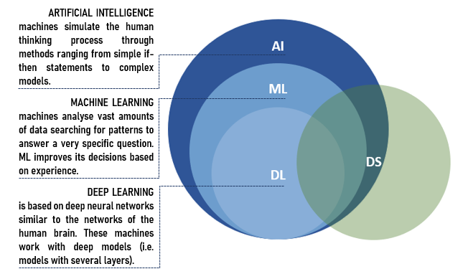

DL
Can we make the machine learn like like how human brain try to learn things? Using Multi Neural Network Architecture.
Artificial Neural Network
Convolution Neural Network
Recurrent Neural Netwok

Slide 3

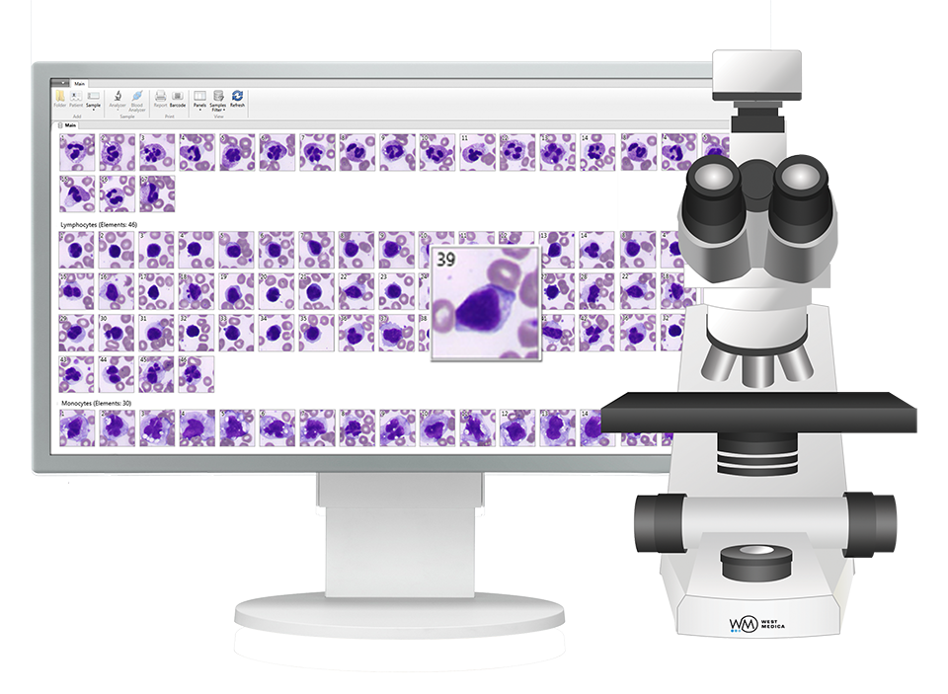
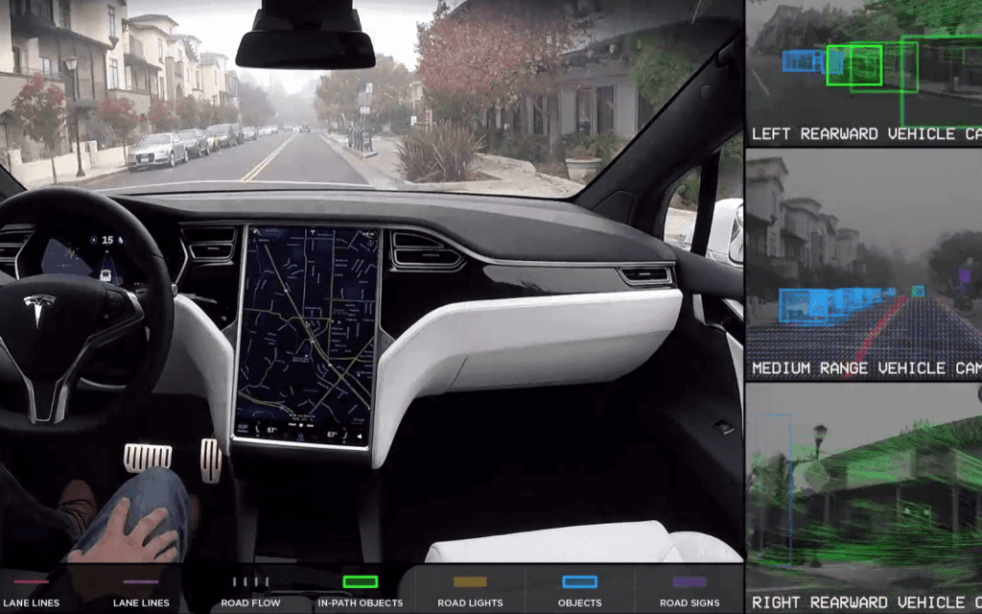
Application of Computer Vision

Slide 4
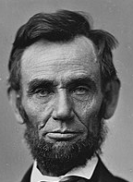
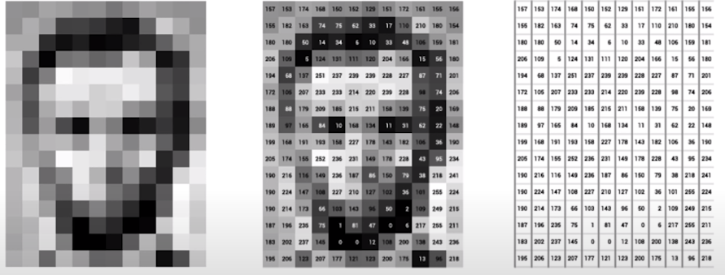
Image are Number
An image is just a matrix of numbers [0,255]
1080x1080x3 for an RGB image

Slide 5
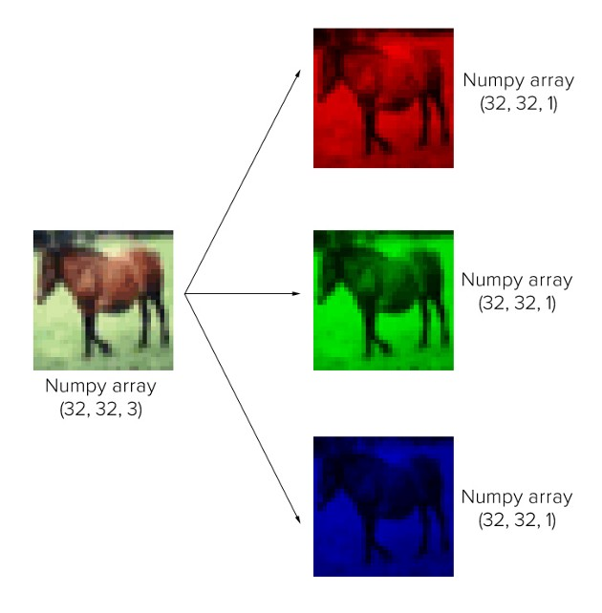
RGB Images

Slide 6
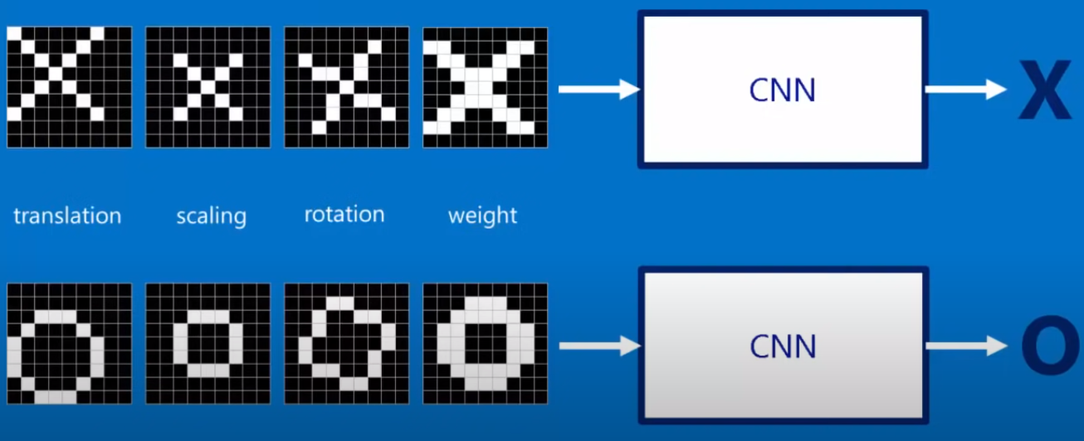
Image are Number

Slide 7
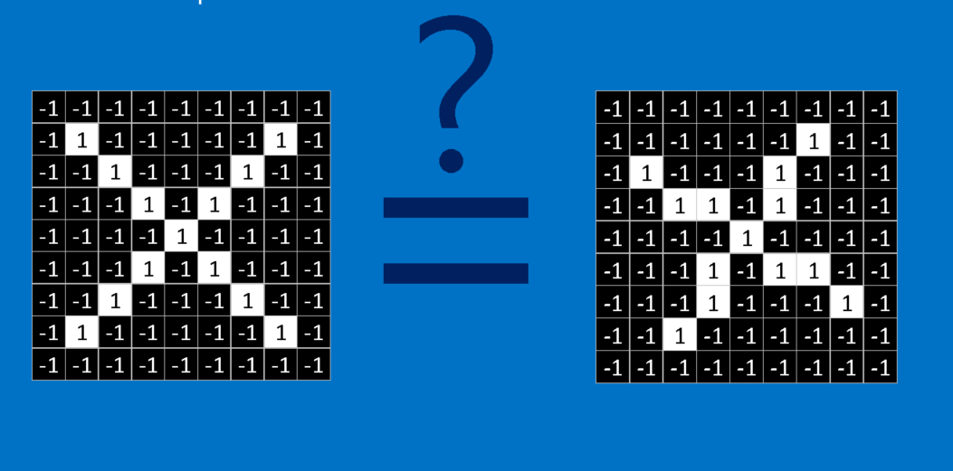
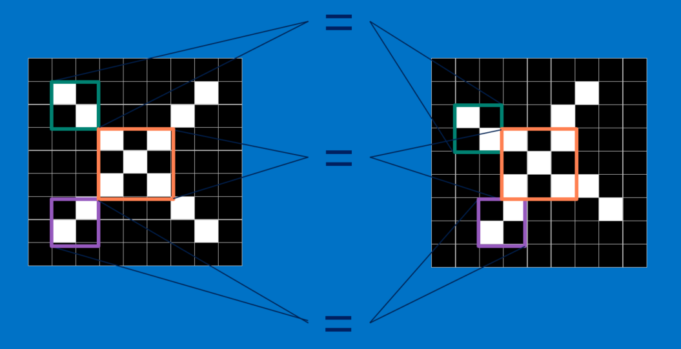
Image are Number
CNNs compare images piece by piece. The pieces that it looks for are called features.

Slide 8
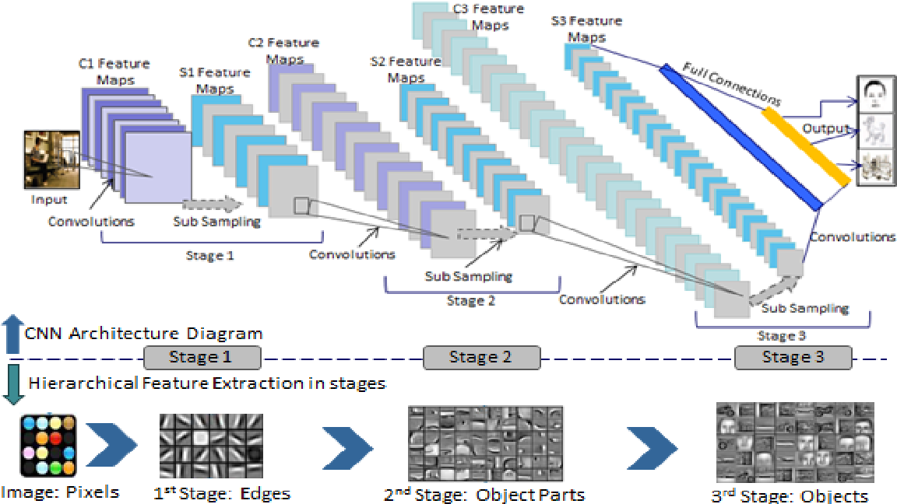
Hierarchy of Features
Feature Hierarchies for Object Classification is a method which used to Automatically extracting informative feature hierarchies for object classification top-down manner.

Slide 9
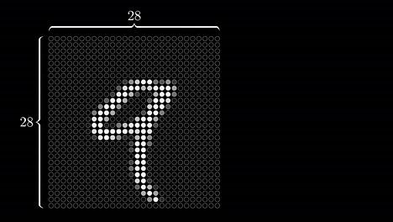
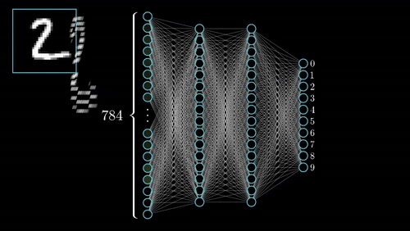

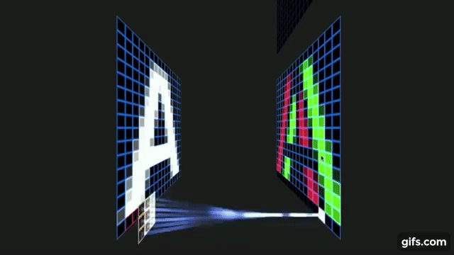
Learning visual features
NN
CNN

Slide 10

Operasi Konvolusi
Operasi konvolusi gambar 5x5 dengan filter 3x3
1 | 1 | 1 | 0 | 0
0 | 1 | 1 | 1 | 0
0 | 0 | 1 | 1 | 1
0 | 0 | 1 | 1 | 0
0 | 1 | 1 | 0 | 0
1 | 0 | 1
0 | 1 | 0
1 | 0 | 1
$$⨂$$
gambar
filter
Operasi Konvolusi
Menggeser filter pada input gambar dari kiri ke kanan lanjut dari atas ke bawah, setiap pergerseran dilakukan operasi perkalian berdasarkan elemen (element-wise multiply / Hadamard Product) kemudian jumlahkan
(Setiap pergeseran dilakukan dot product untuk matriks)

Slide 11
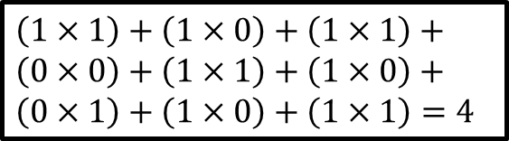

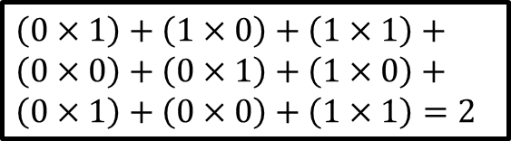
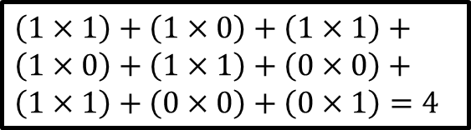

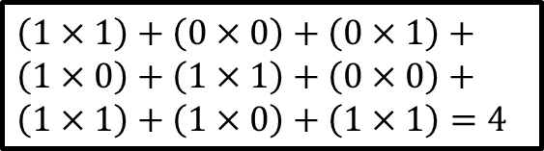
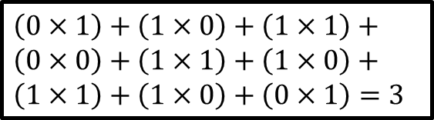
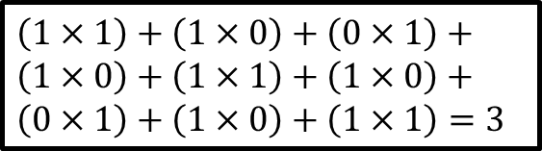
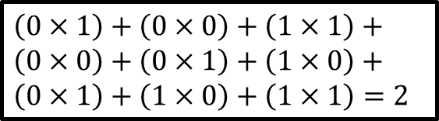
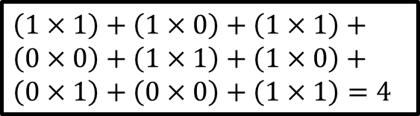
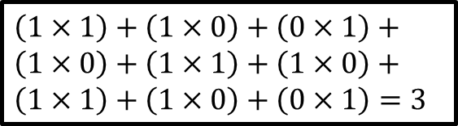
Operasi Konvolusi
$\left(1×1\right)+\left(1×0\right)+\left(0×1\right)+$
$\left(1×0\right)+\left(1×1\right)+\left(1×0\right)+$
$\left(0×1\right)+\left(1×0\right)+\left(1×1\right)=3$
$\left(1×1\right)+\left(0×0\right)+\left(0×1\right)+$
$\left(1×0\right)+\left(1×1\right)+\left(0×0\right)+$
$\left(1×1\right)+\left(1×0\right)+\left(1×1\right)=4$
$\left(1×1\right)+\left(1×0\right)+\left(1×1\right)+$
$\left(1×0\right)+\left(1×1\right)+\left(0×0\right)+$
$\left(1×1\right)+\left(0×0\right)+\left(0×1\right)=4$
$\left(0×1\right)+\left(1×0\right)+\left(1×1\right)+$
$\left(0×0\right)+\left(1×1\right)+\left(1×0\right)+$
$\left(1×1\right)+\left(1×0\right)+\left(0×1\right)=3$
$\left(0×1\right)+\left(0×0\right)+\left(1×1\right)+$
$\left(0×0\right)+\left(0×1\right)+\left(1×0\right)+$
$\left(0×1\right)+\left(1×0\right)+\left(1×1\right)=2$
$\left(1×1\right)+\left(1×0\right)+\left(0×1\right)+$
$\left(1×0\right)+\left(1×1\right)+\left(1×0\right)+$
$\left(1×1\right)+\left(1×0\right)+\left(0×1\right)=3$
$\left(1×1\right)+\left(1×0\right)+\left(1×1\right)+$
$\left(0×0\right)+\left(1×1\right)+\left(1×0\right)+$
$\left(0×1\right)+\left(1×0\right)+\left(1×1\right)=4$
$\left(0×1\right)+\left(1×0\right)+\left(1×1\right)+$
$\left(0×0\right)+\left(0×1\right)+\left(1×0\right)+$
$\left(0×1\right)+\left(0×0\right)+\left(1×1\right)=2$
$\left(1×1\right)+\left(1×0\right)+\left(1×1\right)+$
$\left(0×0\right)+\left(1×1\right)+\left(1×0\right)+$
$\left(0×1\right)+\left(0×0\right)+\left(1×1\right)=4$
x 1 | x 0 | x 1
x 0 | x 1 | x 0
x 1 | x 0 | x 1
x 1 | x 0 | x 1
x 0 | x 1 | x 0
x 1 | x 0 | x 1
x 1 | x 0 | x 1
x 0 | x 1 | x 0
x 1 | x 0 | x 1
1 | 1 | 1 | 0 | 0
0 | 1 | 1 | 1 | 0
0 | 0 | 1 | 1 | 1
0 | 0 | 1 | 1 | 0
0 | 1 | 1 | 0 | 0
1 | 1 | 1 | 0 | 0
0 | 1 | 1 | 1 | 0
0 | 0 | 1 | 1 | 1
0 | 0 | 1 | 1 | 0
0 | 1 | 1 | 0 | 0
1 | 1 | 1 | 0 | 0
0 | 1 | 1 | 1 | 0
0 | 0 | 1 | 1 | 1
0 | 0 | 1 | 1 | 0
0 | 1 | 1 | 0 | 0
1 | 1 | 1 | 0 | 0
0 | 1 | 1 | 1 | 0
0 | 0 | 1 | 1 | 1
0 | 0 | 1 | 1 | 0
0 | 1 | 1 | 0 | 0
1 | 1 | 1 | 0 | 0
0 | 1 | 1 | 1 | 0
0 | 0 | 1 | 1 | 1
0 | 0 | 1 | 1 | 0
0 | 1 | 1 | 0 | 0
1 | 1 | 1 | 0 | 0
0 | 1 | 1 | 1 | 0
0 | 0 | 1 | 1 | 1
0 | 0 | 1 | 1 | 0
0 | 1 | 1 | 0 | 0
1 | 1 | 1 | 0 | 0
0 | 1 | 1 | 1 | 0
0 | 0 | 1 | 1 | 1
0 | 0 | 1 | 1 | 0
0 | 1 | 1 | 0 | 0
1 | 1 | 1 | 0 | 0
0 | 1 | 1 | 1 | 0
0 | 0 | 1 | 1 | 1
0 | 0 | 1 | 1 | 0
0 | 1 | 1 | 0 | 0
1 | 1 | 1 | 0 | 0
0 | 1 | 1 | 1 | 0
0 | 0 | 1 | 1 | 1
0 | 0 | 1 | 1 | 0
0 | 1 | 1 | 0 | 0
x 1 | x 0 | x 1
x 0 | x 1 | x 0
x 1 | x 0 | x 1
x 1 | x 0 | x 1
x 0 | x 1 | x 0
x 1 | x 0 | x 1
x 1 | x 0 | x 1
x 0 | x 1 | x 0
x 1 | x 0 | x 1
4
4 | 3
4 | 3 | 4
4 | 3 | 4
2
4 | 3 | 4
2 | 4
4 | 3 | 4
2 | 4 | 3
4 | 3 | 4
2 | 4 | 3
2
4 | 3 | 4
2 | 4 | 3
2 | 3
1 | 0 | 1
0 | 1 | 0
1 | 0 | 1
4 | 3 | 4
2 | 4 | 3
2 | 3 | 4
1 | 0 | 1
0 | 1 | 0
1 | 0 | 1
x 1 | x 0 | x 1
x 0 | x 1 | x 0
x 1 | x 0 | x 1
x 1 | x 0 | x 1
x 0 | x 1 | x 0
x 1 | x 0 | x 1
x 1 | x 0 | x 1
x 0 | x 1 | x 0
x 1 | x 0 | x 1
$$⨂$$
$$⨂$$
$$=$$
$$=$$
gambar
filter / kernel
feature map
Menggeser filter pada input gambar dari kiri ke kanan lanjut dari atas ke bawah, setiap pergerseran dilakukan operasi perkalian berdasarkan elemen kemudian jumlahkan

Slide 12

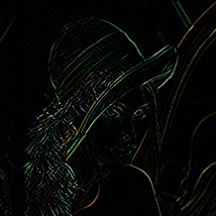
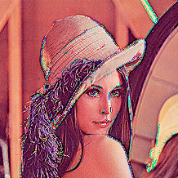
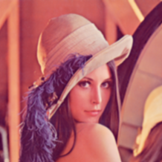
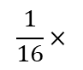
Operasi Konvolusi – Producing Feature Map
Original
Edge Detection
Sharpen
Gaussian Blur
1 | 0 | -1
0 | 0 | 0
-1 | 0 | 1
0 | -1 | 0
-1 | -5 | -1
0 | -1 | 0
1 | 2 | 1
2 | 4 | 2
1 | 2 | 1
$$\frac{1}{16}×$$
Link code:
https://github.com/maftuhm/deep-learning-dsu/blob/main/convolution.ipynb

Slide 13

Convolutional Neural Networks (CNNs)
1. Convolution: Menghasilkan feature map
2. Non-Linearity: Sigmoid, ReLU etc.
3. Pooling: Operasi downsampling untuk setiap feature map
Melatih model dengan data gambar dan menentukan bobot dari filter di dalam layer konvolusi

Slide 14
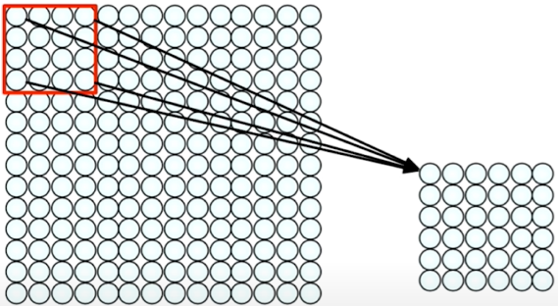
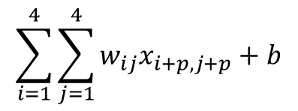
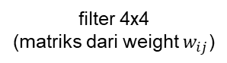
Convolutional Layers
Sebuah neuron pada hidden layer:
1. Mengambil beberapa input berdasarkan
filter yg bersesuaian
2. Menghitung jumlah setiap input yg sudah
dikalikan dengan weight
3. Menjumlahkan dengan bias
4. Dipetakan ke dalam fungsi
nonlinear (diaktivasi)
$$\sum_{i=1}^{4}{\sum_{j=1}^{4}{w_{ij}x_{i+p,j+p}+b}}$$
filter 4x4
(matriks dari weight $w_{ij}$)
Operasi Konvolusi

Slide 15
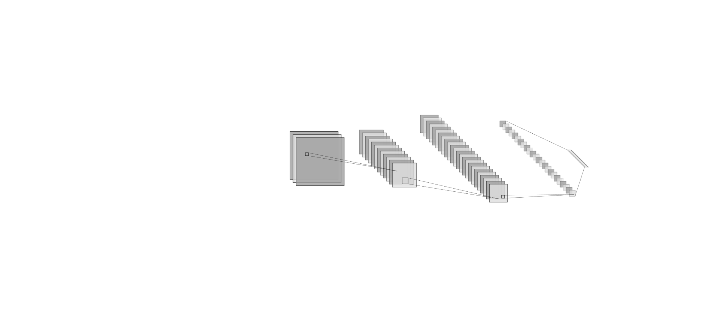
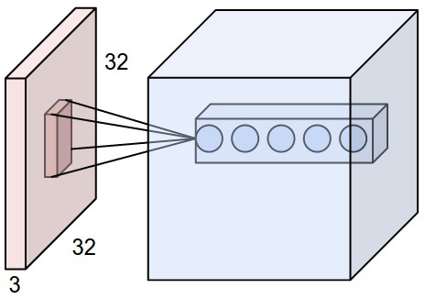
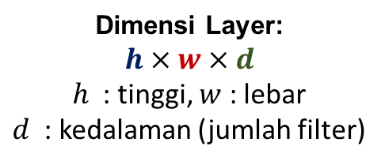
CNNs: Spatial Arrangement of Output Volume
depth
depth
height
height
width
width
Dimensi Layer:
$$h×w×d$$
$h$ : tinggi, $w$ : lebar
$d$ : kedalaman (jumlah filter)
Stride:
Ukuran step filter
yaitu seberapa jauh filter bergeser
(pada contoh sebelumnya stride=1)
Receptive Field:
Lokasi pada input gambar
yang bersesuaian dengan
setiap pergeseran filter

Slide 16


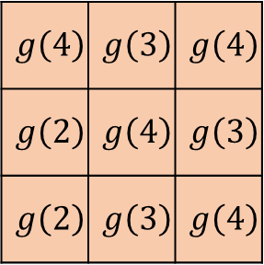

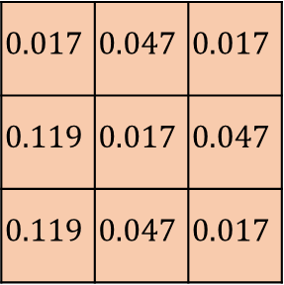
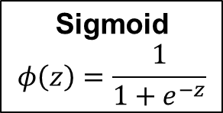
Non-Linearity
Setelah layer konvolusi dilakukan operasi dengan “memasukan” setiap nilai piksel kedalam fungsi non linear
$$\text{Sigmoid}$$
$$φ\left(z\right)=\frac{1}{1+e^{−z}}$$
4 | 3 | 4
2 | 4 | 3
2 | 3 | 4
$$g\left(4\right)$$ | $$g\left(3\right)$$ | $$g\left(4\right)$$
$$g\left(2\right)$$ | $$g\left(4\right)$$ | $$g\left(3\right)$$
$$g\left(2\right)$$ | $$g\left(3\right)$$ | $$g\left(4\right)$$
$$0.017$$ | $$0.047$$ | $$0.017$$
$$0.119$$ | $$0.017$$ | $$0.047$$
$$0.119$$ | $$0.047$$ | $$0.017$$
$$φ$$
$$=$$
feature map

Slide 17

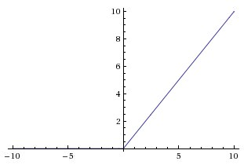
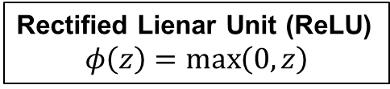
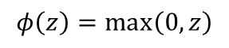
Non-Linearity
Setelah layer konvolusi dilakukan operasi dengan “memasukan” setiap nilai piksel kedalam fungsi non linear
Rectified Lienar Unit (ReLU)
$$φ\left(z\right)=\max\left(0, z\right)$$
$$φ\left(z\right)=\max\left(0, z\right)$$

Slide 18
Pooling
Mereduksi input secara spasial dengan operasi down-sampling (mengurangi jumlah parameter) untuk mengurangi sumber daya komputasi
Max Pooling
Average Pooling
29 | 15 | 28 | 184
0 | 100 | 70 | 38
12 | 12 | 7 | 2
12 | 12 | 45 | 6
29 | 15 | 28 | 184
0 | 100 | 70 | 38
12 | 12 | 7 | 2
12 | 12 | 45 | 6
100 | 184
12 | 45
36 | 80
12 | 15
max pooling dengan filter 2x2 dan stride 2
average pooling dengan filter 2x2 dan stride 2

Slide 19
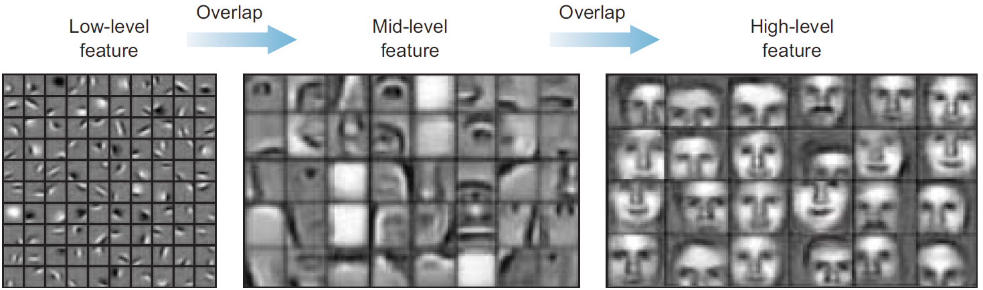
Learning Process on CNNs
Conv Layer 1
Conv Layer 2
Conv Layer

Slide 20

Feature Learning
Mempelajari fitur-fitur dari input gambar melalui operasi konvolusi
Fungsi non-linear sebagai fungsi aktivasi setelah layer konvolusi
Mereduksi dimensi feature map dengan pooling

Slide 21

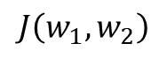
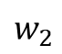
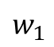
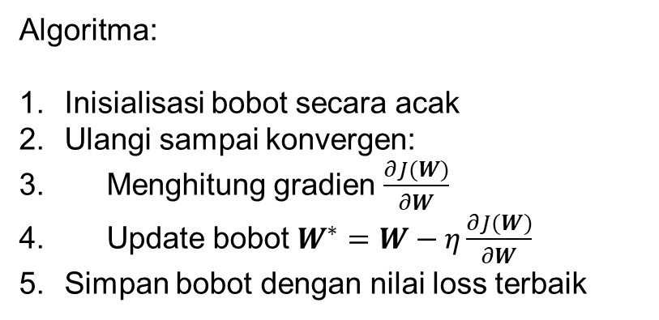
Training NN
Algoritma:
Inisialisasi bobot secara acak
Ulangi sampai konvergen:
Menghitung gradien $\frac{∂J(W)}{∂W}$
Update bobot $W^{∗}=W−η\frac{∂J(W)}{∂W}$
Simpan bobot dengan nilai loss terbaik
$$J\left(w_{1}, w_{2}\right)$$
$$w_{1}$$
$$w_{2}$$

Slide 22
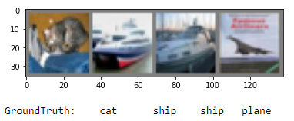
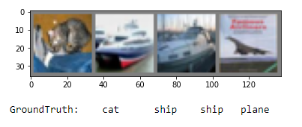
Latihan - Data
Kelas: plane, car, bird, cat, deer, dog, frog, horse, ship, truck

Slide 23
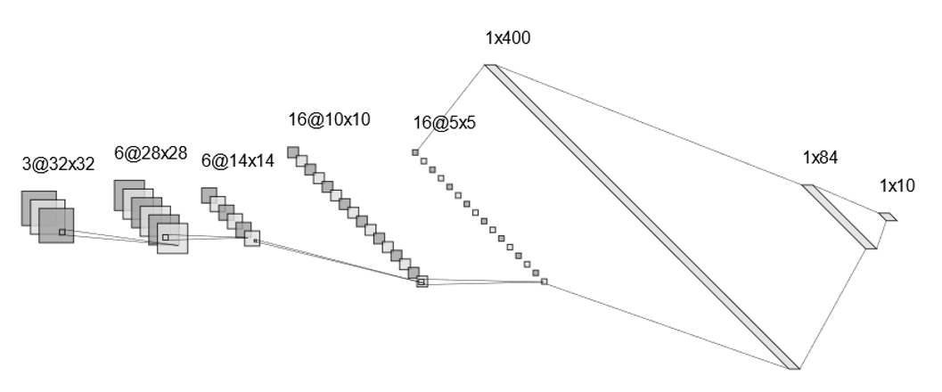
Latihan – Arsitektur CNN
Convolution + ReLU
depth/filter 6
Max Pool
(2x2)
Convolution + ReLU
depth/filter 16
Max Pool
(2x2)
Flatten + ReLU
Dense 84 + ReLU
Output 10
Feature Learning
Classification

Slide 24
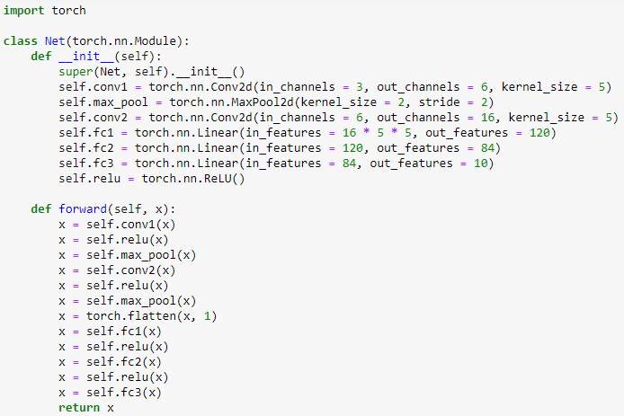
Latihan - Code
hidden layer 1
maxpool
hidden layer 2
maxpool
fully connected
dense layer 1 + ReLu
dense layer 2 + ReLu
output
https://github.com/maftuhm/deep-learning-dsu/blob/main/convolutional-neural-networks.ipynb

Slide 25
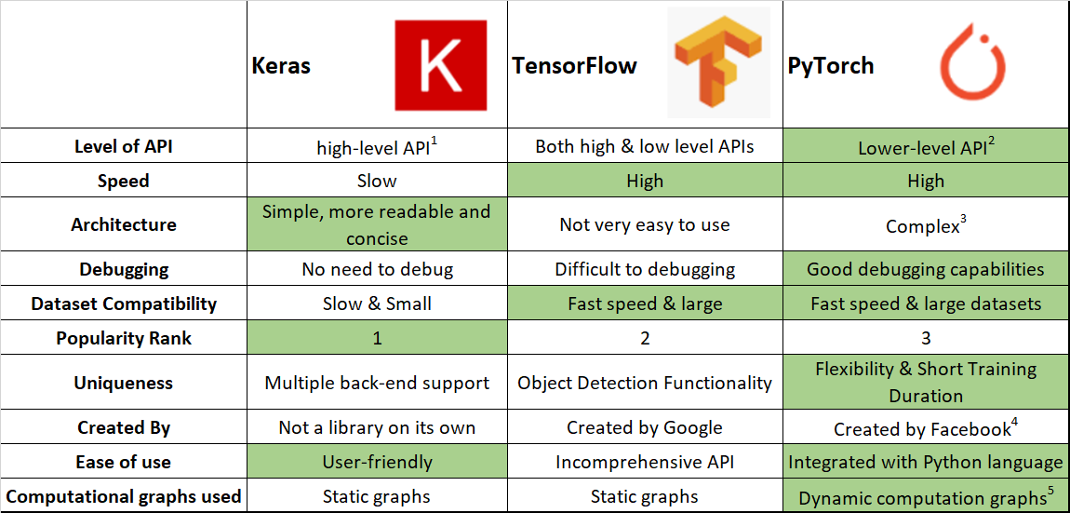
Tools – Keras vsTensorflow vs PyTorch

Slide 26
Terima kasih

